Slide 1

OOPS
BY
ARISHMA

Slide 2
Introduction
OOPs stands for Object Oriented Programming System.
Object-Oriented Programming is a methodology or paradigm to design a program using classes and objects.
It simplifies software development and maintenance.

Slide 3
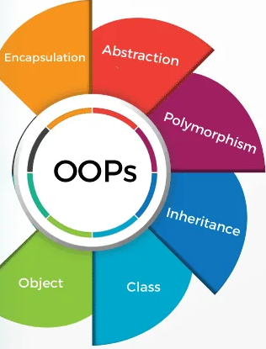
Types
Class
Object
Encapsulation
Inheritance
Polymorphism
Abstraction

Slide 4
Class
Blueprint of creating an object or Template for an object.
All the objects present inside the class.
Example – Fruits , Cars , Vegetables.

Slide 5
Object
An Object can be defined as an instance of a class.
Any entity that has state and behavior is known as an object.
When individual object is created it inherits all the methods and variables from class.
Example: A dog is an object because it has states like color, name, breed, etc.
As well as behaviors like wagging the tail, barking, eating, etc.

Slide 6
Encapsulation
It Hides the sensitive the data from user.
Binding (or wrapping) data and methods together into a single unit
It provides public Get and Set method to access and update the values of private variable.
Example - A capsule, it is wrapped with different medicines.

Slide 7
Inheritance
Inheritance is the mechanism in which one object acquires all the properties and behaviors of a parent object.
The idea behind inheritance in Java is that you can create new classes that are built upon existing classes. When you inherit from an existing class, you can reuse methods and fields of the parent class.
The extends keyword indicates that you are making a new class that derives from an existing class. It is classified into two categories.
Sub Class: Subclass is a class which inherits the other class. It is also called a derived class, extended class, or child class.
Super Class: Superclass is the class from where a subclass inherits the features. It is also called a base class or a parent class.

Slide 8
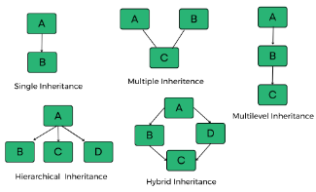
Types of Inheritance

Slide 9
Polymorphism
Polymorphism in Java is a concept by which we can perform a single action in different ways.
Polymorphism is derived from 2 Greek words: poly and morphs. The word "poly" means many and "morphs" means forms. So polymorphism means many forms.
In inheritance it inherits the method and attributes into another class, polymorphism uses that method to perform different action.
Types of Polymorphism
There are two types of polymorphism in Java:
Compile-time polymorphism
Runtime polymorphism.

Slide 10
Abstraction
A class which is declared with the abstract keyword is known as an abstract class in Java.
Abstraction is a process of hiding the implementation details and showing only functionality to the user.
Another way, it shows only essential things to the user and hides the internal details.
There are two ways to achieve abstraction in java
Abstract class
Abstract Method

Slide 11
The End.

